Slide 1
Azure Event Hubs 與 Stream Analytics

Slide 2

Azure IoT 資料流情境
事件來源
收集
擷取 (broker)
轉換
永久儲存
資料呈現或因應動作
串流分析
Web/應用程式 儀表板
應用程式
Service bus
傳統 IOT (自訂通訊協定)
事件中樞
Azure DBs
串流處理
搜尋與查詢
一般裝置
Cloud gateways (web APIs)
Azure storage
具備 IP 的裝置 (Windows/Linux)
儲存體 連接器
HDInsight
資料分析 (Excel)
低功耗裝置 (RTOS)
Field gateways
觸發裝置反應

Slide 3
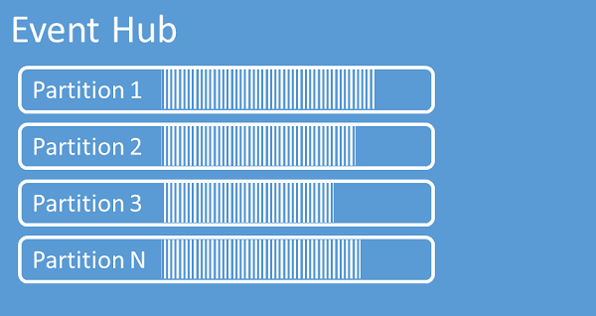

Azure Event Hubs
做為訊息傳遞到雲端平台的佇列服務
每秒處理數百萬個事件
支援 AMQP 或 REST (HTTPS) 傳遞資料
支援多個分割（partition）增加平行處理

Slide 4
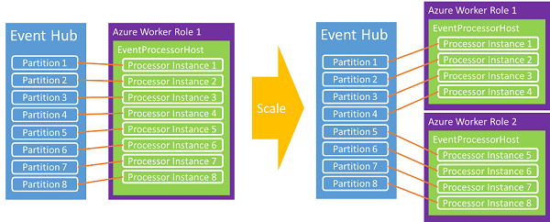
延展事件中樞的效能
事件中樞僅是佇列資料，每筆資料大小上限為 64KB，需另外寫程式將資料讀出
透過更多的分割來承載更大的資料頻寬
接收端可以透過更多的實體來增加讀取的頻寬

Slide 5
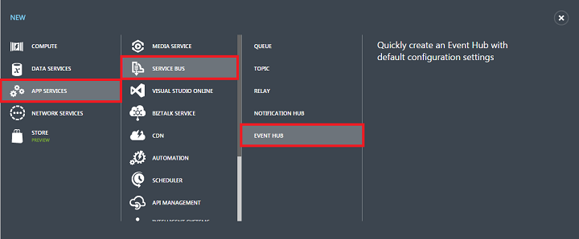
建立事件中樞流程
事件中樞是服務匯流排（Service Bus）中的一個服務
操作的權限控管與服務匯流排一致
分割數需要在建立時決定，範圍從 8 ~ 32

Slide 6
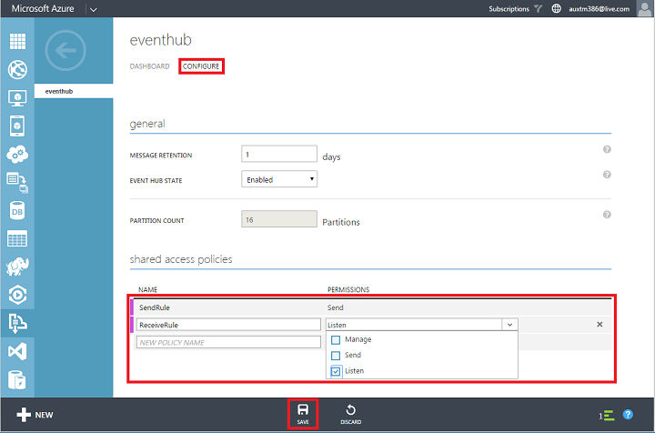
設定訊息保留時間及存取原則
設定訊息保留在事件中樞內的時間，最多可以設定至 14 天
可以設定不同的存取原則，像是只能送或只能收或是是否包含管理權限
設定完存取原則後可以在下方取得不同原則的金鑰

Slide 7
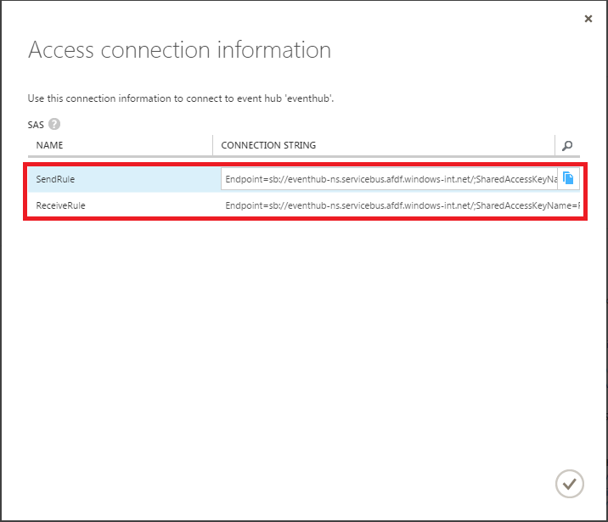
連接字串
設定完存取原則後在事件中樞的儀表板中找到連接字串
不同用途的程式就使用不同的連接字串

Slide 8
Demo
傳送資料到 Azure Event Hubs

Slide 9
Azure 串流分析 (Stream Analytics)

Slide 10



Azure 串流分析
由 Azure 管理的即時分析服務
可靠度及延展性能可用於商業應用
快速完成開發

Slide 11





為什麼要在雲端使用串流分析?
資料不全在本地端
把操作套用在資料上 而非把資料搬到操作程序中
已經在雲端的 事件資料
事件資料 分佈在全球
減少成本
彈性擴充
服務
不是硬體建設

Slide 12

應用程式架構
一個典型 Azure 串流分析的應用程式架構
資料輸入
事件來源
資料輸出
[查詢結果]
串流分析
查詢
Azure 事件中心
Azure SQL DB
Events
資料有定義好的結構，按照時間順序暫存
Azure Blob 儲存體
Azure Blob 儲存體
Azure 事件中心
其它參考資料
一但有新的事件資料都會套用串流分析的查詢
Notes:
Now let us dig deeper into what a typical ASA application looks like. An ASA application has three major components:
Input – Inputs are the sources of events. Note that the ‘original’ source of streaming events are devices, machines, applications, sensors, applications etc. However, ASA is not intended to connect to them directly. Rather ASA lets Azure Event Hubs be the primary interface to the wide variety of event sources. ASA is optimized to get streaming data from Azure Event Hubs and Azure Blob Storage. Azure Blob Storage is the likely place where log data is stored. The list of input sources that ASA directly integrates with may increase in the future, but Azure Event Hubs and Azure Blob Storage will be the primary sources.
Query – Queries are the main component of an ASA application. Queries implement the “analytics logic”. Queries are a set of transformations that are applied to the input stream to produce another set of output events. Queries are the only thing that an ASA application developers actually ‘develops’. Everything else is done through guided wizards in the Azure Portal. Note that ASA has a SQL-like query language but unlike traditional databases, ASA queries run continuously against the stream of incoming events. The queries stop being applied only when the job itself stops.
Output – As queries execute they continuously produce results. The results can be stored in Blob Storage, Event Hubs or Azure SQL database. Note that if the output is stored in Event Hub or Blob Storage, it can become the input to another ASA job. So it is possible to ‘chain’ together multiple jobs to implement a series of transformations.

Slide 13
實際操作
Notes:
Speaker Notes:
Now that we understand what an ASA application looks like conceptually let us get start understanding how to develop one.
This slide is just to let the audience know that we are now transitioning from a high level discussion to lower level technical details.

Slide 14
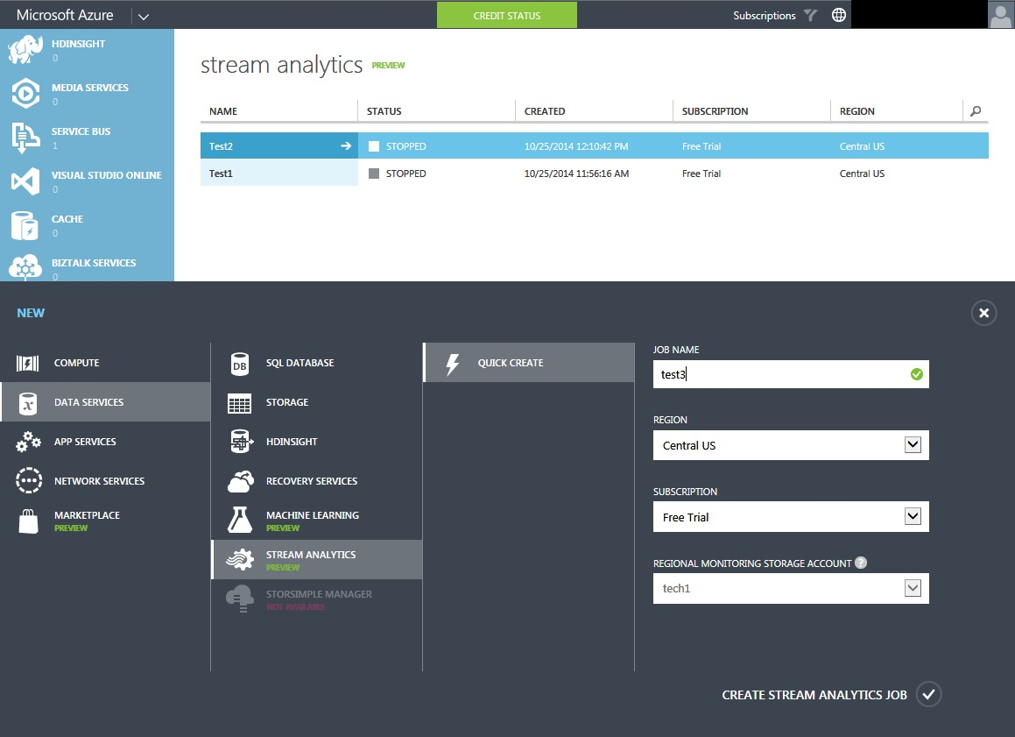
在管理後台中新增串流分析工作
在 Azure 管理後台中進行串流分析的操作
透過精靈一步步建立串流分析的工作
建立工作時選擇的儲存體是用來儲存監控相關的記錄
工作建立好後並不會立刻執行，可以根據需要再啟動它
Notes:
The first step is to create an ASA ‘Job’. ASA Jobs are created using the Azure Portal. The Job creation Portal can be accessed through this path: Data Services -> Stream Analytics (Preview) ->Quick Create.[Obviously one must subscribe to the ASA preview to access the service].
Note:
The storage account is used to store only the ‘monitoring’ data
This wizard does NOT start the job. Starting a Job is an explicit operation as explained later in the deck.
Speaker Notes:
Highlight that ASA is fully integrated with/into the Azure portal. The Azure Portal is the primary tool to interface with ASA. The entire lifecycle of an ASA job can be managed through the Azure Portal.

Slide 15
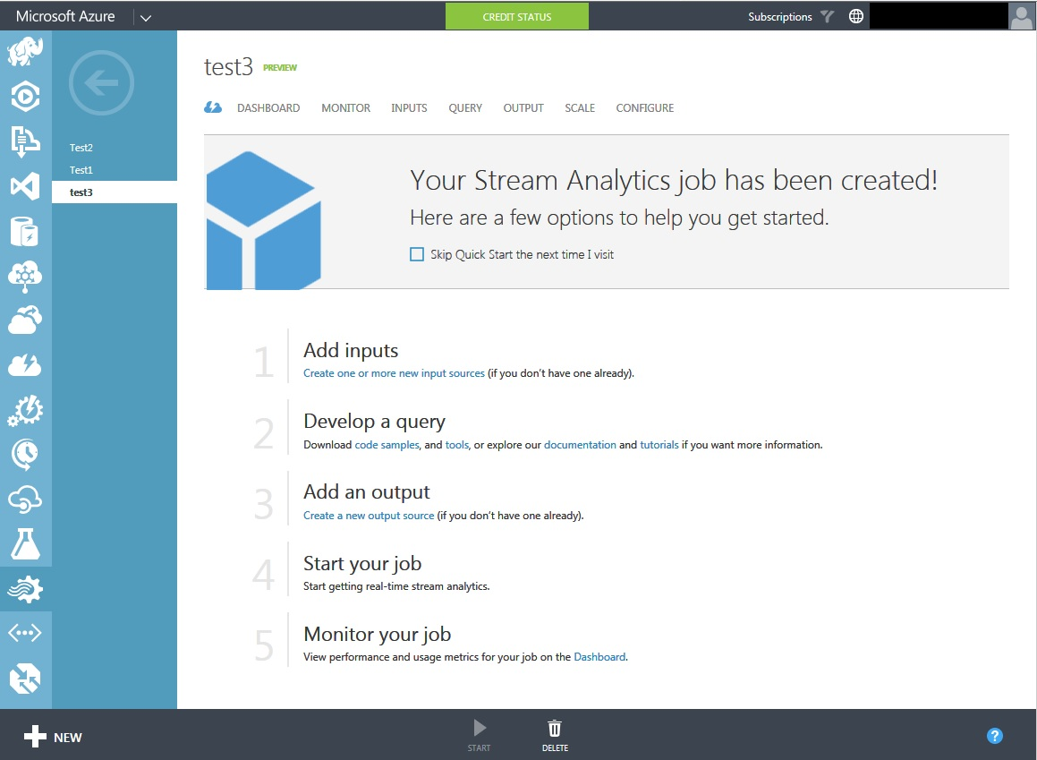
建立工作的流程
Notes:
After you create a Job, you will get this screen. This lists all the activities in in the lifecycle of a typical ASA Job.
Before you can start a Job you have to:
Add Input sources (at least one)
Develop the query
Add an output source
After you start the Job you monitor the job for (a) runtime behavior and (b) performance via a comprehensive set of metrics.
If not satisfactory you can try to improve performance by providing additional computing resources to the job. Sometimes you may have to rewrite/redesign your query.
While the job is running you can check how many events are being correctly processed and how many result in errors.
All of this can be done through the Azure Portal itself.
Speaker Notes:
Use this slide as the anchor slide for the presentation. This slide repeats so that audience knows where they are in the overall flow of the presentation.
Mention that the rest of the presentation is a deep dive into each of the steps listed here.

Slide 16
建立工作的流程
Notes:
Speaker Notes:
Mention that next we will now go deeper into the first step (Adding Inputs).

Slide 17
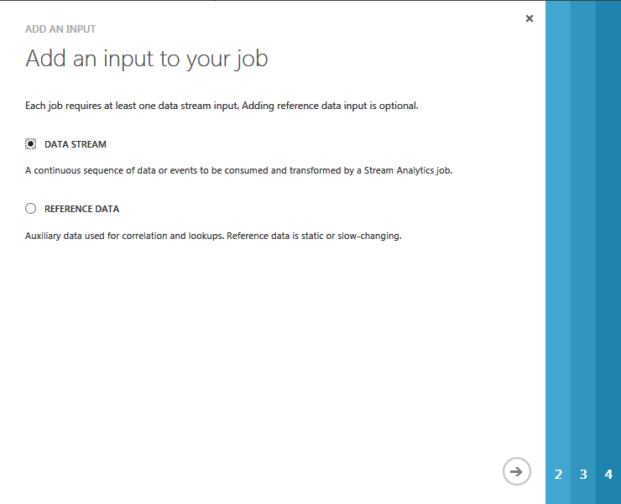
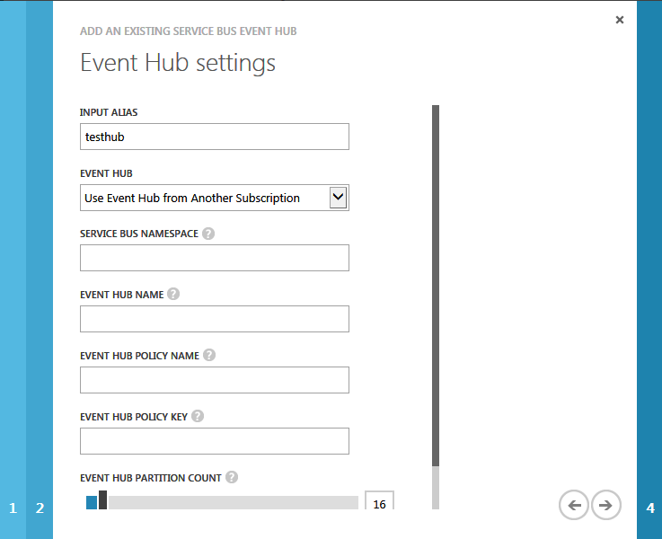
設定串流分析工作的資料來源
目前支援從 Azure 事件中心 以及 Azure Blob 儲存體讀取串流資料，可以同時設定多組輸入來源
進階選項中可以設定從資料來源中何處讀取資料 (像是哪一個資料來或是事件中心佇列等).
參考資料一般來說都是靜態的，或是很少變動.
資料必須是儲存在 Azure Blob 儲存體中
為了效能考量會快取資料
Notes:
The Azure portal provides wizards to guide the user through the processing of adding inputs.
Every Job must have at least one data stream source. It can have multiple data streams. Currently supported data stream sources are Event Hubs and Blob Storage.
Reference data is optional. Ref data is usually data that changes infrequently. An example might be a product catalog, data that maps city name to zipcode, customer profile data etc.
Ref data is cached in memory for improved performance.
Currently ref data must be in Blob Storage.
The wizard collects all the information needed to read events from the input data.
Blob Storage advanced option lets you specify additional details such as:
Blob Serialization boundary: This setting determines when a blob is ready for reading. Stream Analytics supports Blob Boundary (the blob can be uploaded as a single piece or in blocks, but every block must be committed before the blob is read and can't be appended) and Block Boundary (blocks can be continuously added, and each block is individually readable and can be read as it's committed).
Path Pattern: The file path used to locate your blobs within the specified container. Within the path, you may choose to specify one or more instances of the following 3 variables: {date}, {time}, {partition}. Ex 1: cluster1/logs/{date}/{time}/{partition} or Ex 2: cluster1/logs/{date}
You can test whether you entered the correct information by testing for connectivity
Every data streams must have a name (Input Alias). You use this name in the query to refer to a specific data stream. [It is the name of the ‘table’ you select from; more on this later].

Slide 18
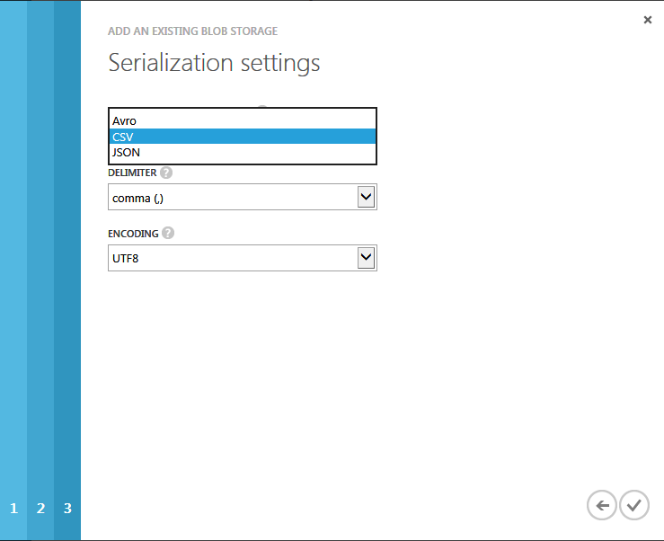
定義串流資料格式
設定資料序列化的格式及字元編碼 (資料串流及參考資料都要設定).
目前支援三種資料格式：CSV, JSON 以及 Avro.
針對 CSV 格式的資料也可以設定幾種不同的分隔符號，如：逗點 (,)、分號 (;)、冒號 (:)、Tab 字元或空白字元
對於 CSV 及 Avro 資料可以選擇性地加上資料結構的定義
Notes:
In additional the connectivity information for the data sources, you must also specify the serialization format for the events coming from the source.
Currently 3 serialization formats are supported: JSON, CSV and Avro
For CSV format you can specify the delimiter (comma, semi-colon, colon, tab or space).
Only utf-8 encoding is supported for now.

Slide 19
建立工作的流程
Notes:
Now that we are done setting up the input, the next step in the workflow is to develop a query.

Slide 20
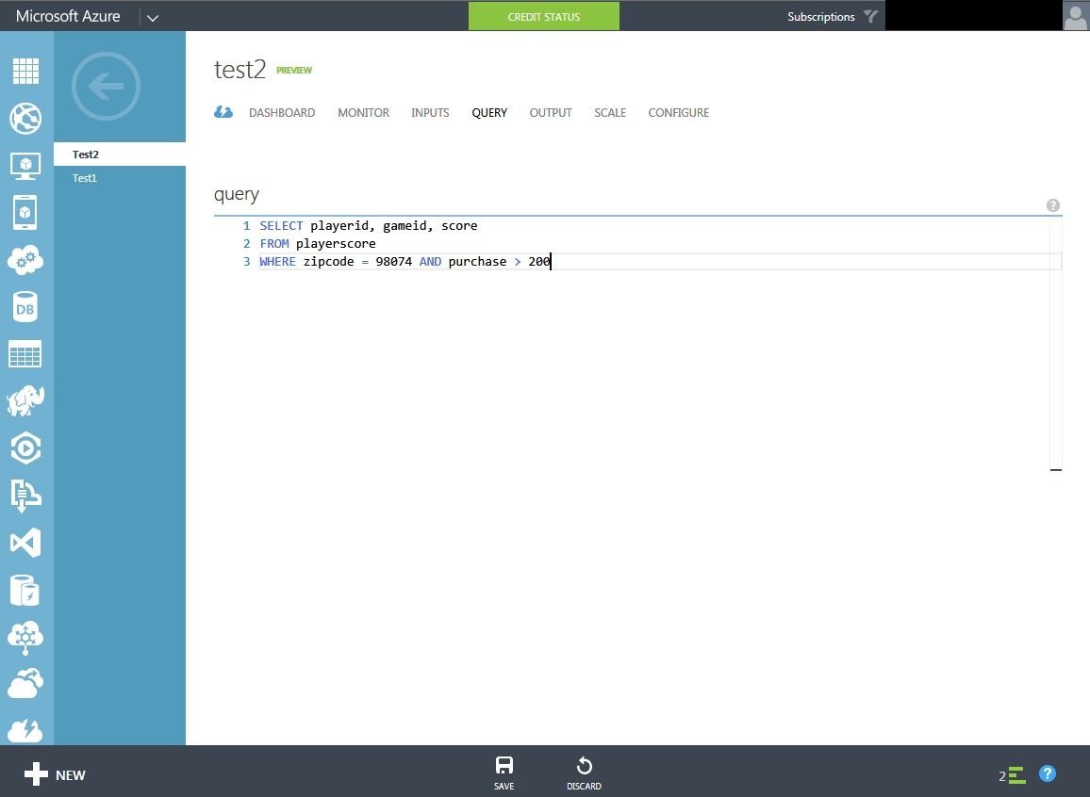
設定查詢語法
類 SQL 語法，是標準 T-SQL 語法的子集
提供區間擴充功能 t讓資料操作可以設定只需在某段時間才執行
可以定義多個查詢讓工作能平行延展處理
透過 Azure 管理後台來撰寫查詢
Notes:
Key points about developing queries for ASA jobs:
You write the query directly in the Azure Portal Query page as shown here.
The ASA Query language is a subset of T-SQL (the query language for SQL Server).
However there are specific extension for querying streaming data such as “Windowing Extensions” (discussed in greater detail in subsequent slides) and to enable parallelism and scale out (also discussed in greater detail later).
This page can detect syntax errors but obviously not runtime errors. Note that all results (if any) goes to the output added for the job. There is no ‘console’ to see the results or errors. If you do not get any results it could be that there is an error in your code or that there are no input events to process. As a query runs continuously waiting for new events, it never comes back to say ‘no input data found’.

Slide 21
查詢語法 – 概觀
DML Statements
SELECT
FROM
WHERE
GROUP BY
HAVING
CASE
JOIN
UNION
Date and Time Functions
DATENAME
DATEPART
DAY
MONTH
YEAR
DATETIMEFROMPARTS
DATEDIFF
DATADD
Aggregate Functions
SUM
COUNT
AVG
MIN
MAX
Scaling Functions
WITH
PARTITION BY
Windowing Extensions
Tumbling Window
Hopping Window
Sliding Window
Duration
String Functions
LEN
CONCAT
CHARINDEX
SUBSTRING
PATINDEX
Notes:
Speaker Notes:
Mention that this slide provides an at-a-glance overview of the query capabilities of the SA query language. As noted earlier while some/most of the operators are vanilla T-SQL capabilities there are some features specific to analysis of streaming data such as the Windowing Extensions, scaling functions, DATEDIFF etc.
The subsequent slides will go into these functions in greater detail.

Slide 22
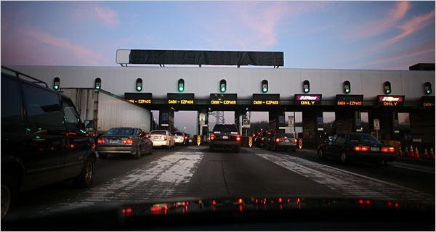
Sample Scenario – Toll Station
EntryStream - Data about vehicles entering toll stations
ExitStream - Data about cars leaving toll stations
TollId | EntryTime | License Plate | State | Make | Model | Type | Weight
1 | 2014-10-25T19:33:30.0000000Z | JNB 7001 | NY | Honda | CRV | 1 | 3010
1 | 2014-10-25T19:33:31.0000000Z | YXZ 1001 | NY | Toyota | Camry | 2 | 3020
3 | 2014-10-25T19:33:32.0000000Z | ABC 1004 | CT | Ford | Taurus | 2 | 3800
2 | 2014-10-25T19:33:33.0000000Z | XYZ 1003 | CT | Toyota | Corolla | 2 | 2900
1 | 2014-10-25T19:33:34.0000000Z | BNJ 1007 | NY | Honda | CRV | 1 | 3400
2 | 2014-10-25T19:33:35.0000000Z | CDE 1007 | NJ | Toyota | 4x4 | 1 | 3800
… | … | … | … | … | … | … | …
TollId | ExitTime | LicensePlate
1 | 2014-10-25T19:33:40.0000000Z | JNB 7001
1 | 2014-10-25T19:33:41.0000000Z | YXZ 1001
3 | 2014-10-25T19:33:42.0000000Z | ABC 1004
2 | 2014-10-25T19:33:43.0000000Z | XYZ 1003
… | … | …
ReferenceData - Commercial vehicle registration data
LicensePlate | RegistartionId | Expired
SVT 6023 | 285429838 | 1
XLZ 3463 | 362715656 | 0
QMZ 1273 | 876133137 | 1
RIV 8632 | 992711956 | 0
… | … | ….
Notes:
Speaker Notes:
Next, the presentation will show several ASA queries. For consistency these queries will be based on a tolling station scenario. This slide shows the schema of the 2 input streams and Reference Data, along with some sample data. Each toll station has multiple toll booths. Sensors scan an RFID card affixed to the windshield of a vehicle as it passes the toll booth. It is easy to visualize the passage of vehicles through these toll stations as an event stream over which interesting operations can be performed. Two streams of data -- EntryStream and ExitStream -- are produced respectively by sensors at the entrance and exit of the toll stations. Assume that each vehicle takes a few seconds to minutes to pass through the tool. Here’s the description of the fields:
EntryStream
TollID - Assume that a single station has several booths.
EntryTime - The date and time of entry of the vehicle to the toll booth in UTC
LicensePlate - License plate number of the vehicle.
State - State in the USA the car is registered in.
Make -The manufacturer of the automobile.
Model-Model number of the automobile
Type - 1 for “Passenger” vehicles, 2 for “Commercial” vehicles, 3 for “Other”
Weight - Vehicle weight in tons; 0 for passenger vehicles
Exit Data:
TollID - Toll booth ID that uniquely identifies a toll booth.
ExitTime - The date and time of exit of the vehicle from Toll Booth in UTC
LicensePlate - License plate number of the vehicle
Registration Data
LicensePlate - License plate number of the vehicle.
RegistrationId - RegistrationId
Expired - 0 is vehicle registration is active, 1 if registration is expired

Slide 23
Query - Filtering
Filtering the incoming stream based on some criteria is a common operation in ETL and digital shoe box scenarios
Query:
From the incoming stream find only vehicles that:
Are from the states of WA and CA
Weight less than 3000 lbs
License plate number end in 999
Make starts with a “M”
Display “Passenger” if Type = 1, “Commerical” if Type = 2 and “Other” for all other types
Display Time as ‘Mins’, ‘Seconds’, ‘Milliseconds’
SELECT VehicleCategory =
Case Type
WHEN 1 THEN ‘Passenger’
WHEN 2 THEN ‘Commercial’
ELSE THEN ‘Other’
END,
TollId, State LicensePlate, State, Make, Model, Weight,
DATEPART(mi,EntryTime) AS ‘Mins’,
DATEPART(ss,EntryTime) AS ‘Seconds’
DATEPART(ms,EntryTime) AS ‘Milleseconds’
FROM EntryStream TIMESTAMP BY EntryTime
WHERE (State = ‘CA’ OR State = ‘WA’)
AND Weight < 3000
AND CHARINDEX (‘M’, model) = 0
AND PATINDEX(‘%999’, LicensePlate) = 5
Notes:
Speaker Talking points:
A common scenario is to filter the incoming stream based on some criteria. In some cases, given the velocity of the incoming stream, it might not be feasible to process or store all of the events. So prior to further real-time analytics (or storing in a persistent store such as HDFS or Azure Blob Storage), events have to be filtered out. SQL is a very powerful – and elegant – language for filtering. The slide here shows how a simple SQL query can be used to implement a powerful filter.
This query involves string functions (CHARINDEX, PATINDEX) date/time functions (DATEPART) and the ‘CASE’ DML statement.

Slide 24
Temporal Joins
SELECT Make
FROM EntryStream ES TIMESTAMP BY EntryTime
JOIN ExitStream EX TIMESTAMP BY ExitTime
ON ES.Make= EX.Make
AND DATEDIFF(second,ES,EX) BETWEEN 0 AND 10
Join are used to combine events from two or more input sources
Joins are temporal in nature – each JOIN must provide limits on how far the matching rows can be separated in time
Time bounds are specified inside the ON clause using DATEDIFF function
Supports LEFT OUTER JOIN to specify rows from the left table that do not meet the join condition
Useful for pattern detection
Toll
Entry :
{“Mazda”,6}
{“BMW”,7}
{“Honda”,2}
{“Volvo”,3}
Toll
Exit :
{“Mazda”,3}
{“Honda”,2}
{“BMW”,7}
{“Volvo”,3}
Time
(Seconds)
0
5
10
15
20
25
“Honda” – Not in result because event in Exit stream precedes event in Entry Stream
“BMW” – Not in result because Entry and Exit stream events > 10 seconds apart
Query Result = [Mazda, Volvo]
Notes:
Like standard T-SQL, JOINs in the Azure Stream Analytics query language are used to combine records from two or more input sources. JOINs in Azure Stream Analytics are temporal in nature, meaning that each JOIN must provide some limits on how far the matching rows can be separated in time. For instance, saying “join EntryStream events with ExitStream events when they occur on the same LicensePlate and TollId and within 5 minutes of each other” is legitimate; but “join EntryStream events with ExitStream events when they occur on the same LicensePlate and TollId” is not – it would match each EntryStream with an unbounded and potentially infinite collection of all ExitStream to the same LicensePlate and TollId.
The time bounds for the relationship are specified inside the ON clause of the JOIN, using the DATEDIFF function.
The query in this slide joins events in the Entry and Exit Stream only if they are less than 10 seconds apart.
The two “Mazda” events in the EntryStream and ExitStream will NOT be joined because they are more than 10 seconds apart.
The two “Honda” events will not be joined because, even though they are less than 10 seconds apart, the event in the ExitStream has a timestamp earlier than event in the EntryStream. DATEDIFF(second,ES,EX) for these two events will be a negative number.
Note: DATEDIFF used in the SELECT statement uses the general syntax where we pass a datetime column or expression as the second and third parameter. But when we use the DATEDIFF function inside the JOIN condition, we pass the input_source name or its alias. Internally the timestamp associated for each event in that source is picked.
You cannot use SELECT * in JOINS

Slide 25
Query – Find time for cars to pass tolling place
Query
Find the time in seconds required for vehicles to pass the toll. Report time taken to pass the toll
Solution
Join the stream containing EntryTime with the stream containing ExitTime. using TollId and LicencePlate columns.
Use DATEDIFF function to specify that events should be within 15 minutes from each other.
Apply DATEDIFF function to Exit and Entry times to compute actual time a car spends in the toll in seconds
SELECT ES.TollId, ES.EntryTime, EX.ExitTime, ES.EntryTime, ES.LicensePlate DATEDIFF(minute, ES.EntryTime, EX.ExitTime )
FROM EntryStream ES TIMESTAMP BY EntryTime
JOIN ExitStream EX TIMESTAMP BY ExitTime
ON (EX.TollId= ES.TollId and ES.LicensePlate = EX.LicensePlate)
AND DATEDIFF(minute, ES, EX) BETWEEN 0 AND 15
Notes:
In this example we want to report the time required for cars to pass the toll (may be to assess efficiency and customer experience).
For this we need to join EntryTime stream with the ExitTime stream. We will join the two Streams using TollId and LicencePlate columns. Join operator requires specifying temporal wiggle room describing acceptable time difference between join events. We will use DATEDIFF function to specify that events should be within 15 minutes from each other. We will also apply DATEDIFF function to Exit and Entry times to compute actual time a car spends going through the toll station.

Slide 26
Query – List cars not exiting tolling place in 5 min
Query
Reports all cars that have entered the toll but have not exited within 5 minutes
Solution
Join the stream containing EntryTime with the stream containing ExitTime, using TollId and LicencePlate fields.
Use DATEDIFF function to specify that events should be within 5 minutes of each other.
Finally use the LEFT OUTER JOIN operator to select all cars that do not meet the join condition
SELECT ES.TollId, ES.EntryTime, ES.LicensePlate
FROM EntryStream EN TIMESTAMP BY EntryTime
LEFT OUTER JOIN ExitStream EX TIMESTAMP BY ExitTime
ON (EN.TollId= EX.TollId AND EN.LicensePlate = EX.LicensePlate)
AND DATEDIFF(minute, EN, EX) BETWEEN 0 AND 5
WHERE EX.ExitTime IS NULL
Notes:
This query shows how to use the LEFT OUTER JOIN to find rows that do not match the JOIN condition. This is same as how it works in T-SQL. Otherwise the query is similar to one on the previous slide.

Slide 27
Query – Expired Registration
Query
Reports all vehicles that entered the toll with expired licenses
Solution
Use the commercial vehicle registration data as Reference data.
Join the stream containing EntryTime with the RegistrationData using LicensedPlate
Select rows where the Expired=1 (for expired vehicles)
SELECT ES.EntryTime, ES.LicensePlate, ES.TollId, RD.RegistrationId
FROM EntryStream ES TIMESTAMP BY EntryTime
JOIN RegistrationData RD
ON ES.LicensePlate = RD.LicensePlate
WHERE RD.Expired = 1
Notes:
This query demonstrates the use of Reference data. Reference data can be used in a SELECT DML statement. In this example we are using vehicle registration data as reference data. Reference data is not temporal in nature. ASA query language supports developing queries that use both temporal and non-temporal data

Slide 28
UNION
TollId | EntryTime | LicensePlate | …
1 | 2014-09-10 12:01:00.000 | JNB 7001 | …
1 | 2014-09-10 12:02:00.000 | YXZ 1001 | …
3 | 2014-09-10 12:02:00.000 | ABC 1004 | …
TollId | ExitTime | LicensePlate
1 | 2009-06-25 12:03:00.000 | JNB 7001
1 | 2009-06-2512:03:00.000 | YXZ 1001
3 | 2009-06-25 12:04:00.000 | ABC 1004
Combines the results of two or more queries into a single result set that includes all the rows that belong to all the queries in the union
Number and order of the columns must be the same in all queries
Data types must be compatible
If ‘ALL’ not specified duplicate rows are removed
SELECT TollId, ENTime AS Time , LicensePlate FROM EntryStream TIMESTAMP BY ENTime UNION SELECT TollId, EXTime AS Time , LicensePlate FROM ExitStream TIMESTAMP BY EXTime
TollId | Time | LicensePlate
1 | 2014-09-10 12:01:00.000 | JNB 7001
1 | 2014-09-10 12:02:00.000 | YXZ 1001
3 | 2014-09-10 12:02:00.000 | ABC 1004
1 | 2009-06-25 12:03:00.000 | JNB 7001
1 | 2009-06-2512:03:00.000 | YXZ 1001
3 | 2009-06-25 12:04:00.000 | ABC 1004
Notes:
UNION
Combines the results of two or more queries into a single result set that includes all the rows that belong to all queries in the union. The UNION operation is different from using joins that combine columns from two tables.
The following are basic rules for combining the result sets of two queries by using UNION:
The number and the order of the columns must be the same in all queries.
The data types must be compatible.
ALL keyword
Incorporates all rows into the results including duplicates. If not specified, duplicate rows are removed.

Slide 29
Windowing Concepts
Windowing is a core requirement for streaming analytic applications
Common requirement to perform some set-based operation (count, aggregation etc) over events that arrive within a specified period of time
Azure Stream Analytics supports three types of windows: Hopping, Sliding and Tumbling
Every window operation outputs events at the end of the window
The output of the window will be single event based on the aggregate function used. The event will have the time stamp of the window
All windows have a fixed length
All windows should be used in a GROUP BY clause
Event arrive at different times i.e. have unique timestamps
Events arrive at different rates (events/sec).
In any given period of time there may be 0, 1 or more events
Window 1
Window 2
Window 3
1
5
4
6
2
8
6
4
Time
t1
t2
t3
t4
t5
t6
Aggregate
Function (Sum)
Output Events
18
14
Notes:
Windowing (extensions to T-SQL)
In applications that process real-time events, a common requirement is to perform some set-based computation (aggregation) or other operations over subsets of events that fall within some period of time. Because the concept of time is a fundamental necessity to complex event-processing systems, it’s important to have a simple way to work with the time component of query logic in the system. In ASA, these subsets of events are defined through windows to represent groupings by time. A window contains event data along a timeline and enables you to perform various operations against the events within that window. For example, you may want to sum the values of payload field. Every window operation outputs event at the end of the window. The windows of ASA are closed at the window start time and open at the window end time. For example, if you have a 5 minute window from 12:00 AM to 12:05 AM all events with timestamp greater than 12:00 AM and up to timestamp 12:05 AM inclusive will be included within this window. The output of the window will be a single event based on the aggregate function used with a timestamp equal to the window end time. The timestamp of the output event of the window can be projected in the SELECT statement using the System.Timestamp property using an alias. Every window automatically aligns itself to the zeroth hour. For example, a 5 minute tumbling window will align itself to (12:00-12:05] , (12:05-12:10], …
Note: All windows should be used in a GROUP BY clause.
In the example, the SUM of the events in first Window = 1+5+4+6+2 = 18.
Currently all window types are of fixed width (fixed interval)

Slide 30
Tumbling Window
Tumbling windows:
Repeat
Are non-overlapping
A 20-second Tumbling Window
1
5
4
6
2
8
6
5
3
6
1
An event can belong to only one tumbling window
0
10
20
30
40
50
60
Time
(secs)
Query: Count the total number of vehicles entering each toll booth every interval of 20 seconds.
1
5
4
6
2
8
6
SELECT TollId, COUNT(*)
FROM EntryStream TIMESTAMP BY EntryTime
GROUP BY TollId, TumblingWindow(second, 20)
5
3
6
1
Notes:
Tumbling windows specify a repeating, non-overlapping time interval of a fixed size.
Syntax: TUMBLINGWINDOW(timeunit, windowsize)
Timeunit – day, hour, minute, second, millisecond, microsecond, nanosecond.
Windowsize – a bigInteger that described the size (width) of a window.
Note that because tumbling windows are non-overlapping each event can only belong to one tumbling window.
The query just counts the numbers of vehicles passing the toll station every 20 seconds, grouped by Toll Id.

Slide 31
Hopping Window
Hopping windows:
Repeat
Can overlap
Hop forward in time by a fixed period
Same as tumbling window if hop size = window size
Events can belong to more than one hopping window
A 20-second Hopping Window with a 10 second “Hop”
1
5
4
6
2
8
6
5
3
6
1
0
10
20
30
40
50
60
Time
(secs)
1
5
4
6
2
4
6
2
QUERY: Count the number of vehicles entering each toll booth every interval of 20 seconds; update results every 10 seconds
8
6
8
6
5
3
SELECT COUNT(*), TollId
FROM EntryStream TIMESTAMP BY EntryTime
GROUP BY TollId, HoppingWindow (second, 20,10)
5
3
6
1
Notes:
To get a finer granularity of time, we can use a generalized version of tumbling window, called Hopping Window. Hopping windows are windows that "hop" forward in time by a fixed period. The window is defined by two time spans: the hop size H and the window size S. For every H time unit, a new window of size S is created. The tumbling window is a special case of a hopping window where the hop size is equal to the window size.
Syntax
HOPPINGWINDOW ( timeunit , windowsize , hopsize )
HOPPINGWINDOW ( Duration( timeunit , windowsize ) , Hop (timeunit , windowsize )
Note: The Hopping Window can be used in the above two ways. If the windowsize and the hopsize has the same timeunit, you can use it without the Duration and Hop functions.
The Duration function can also be used with other types of windows to specify the window size

Slide 32
Sliding Window
Sliding window:
Continuously moves forward by an € (epsilon)
Produces an output only during the occurrence of an event
Every windows will have at least one event
Events can belong to more than one sliding window
A 20-second Sliding Window
1
5
9
8
0
10
20
30
40
50
Time
(secs)
1
5
1
Query: Find all the toll booths which have served more than 10 vehicles in the last 20 seconds
5
1
9
SELECT TollId, Count(*)
FROM EntryStream ES
GROUP BY TollId, SlidingWindow (second, 20)
HAVING Count(*) > 10
8
Notes:
A Sliding window is a fixed length window which moves forward by an (€) epsilon and produces an output only during the occurrence of an event. An epsilon is one hundredth of a nanosecond.
Syntax
SLIDINGWINDOW ( timeunit , windowsize )
SLIDINGWINDOW(DURATION(timeunit, windowsize), Hop(timeunit, windowsize))

Slide 33
Multi-step queries with “WITH”
A Query with two steps
A query can have multiple steps
Each step is a sub-query defined using the WITH keyword
The only query outside of the WITH keyword is also counted as a step
Steps enable a query to be scaled out across multiple computing resources
Can also be used to develop complex queries more elegantly by creating a temporary named result set
WITH Step1 AS (
SELECT COUNT(*) AS CountItems , TollId
FROM EntryStream Partition By PartitionId
GROUP BY TumblingWindow (minute, 3), TollId
)
SELECT COUNT(CountItems),TollId
FROM Step1
GROUP BY TumblingWindow (minute, 3), TollId
Notes:
Specifies a temporary named result set which can be referenced by a FROM clause in the query. This is defined within the execution scope of a single SELECT statement.
Syntax
[ WITH <result_set_name>]
AS
( SELECT_query_definition )
result_set_name: Is the name of the temporary result-set which can be referenced by a FROM clause of a SELECT statement. This name must be different from the name of any other result_set_name defined within the scope of the query.
SELECT_query_definition: specifies a SELECT statement whose result set populates the result_set_name.
Note: WITH has a special use with respect to scaling out queries. It can be used to define multiple steps that can be executed in parallel. The example query defines two steps. Creating more steps enables more Streaming Units to be assigned to a query. More about Streaming Units later.

Slide 34
建立工作的流程
Notes:
Speaker Notes:
To recap we have so far covered how to add inputs to a Job and develop a query to process the incoming events. Now we will see how to add an output to store the results.

Slide 35
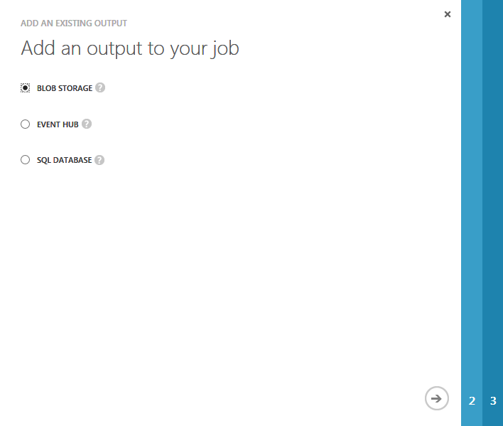
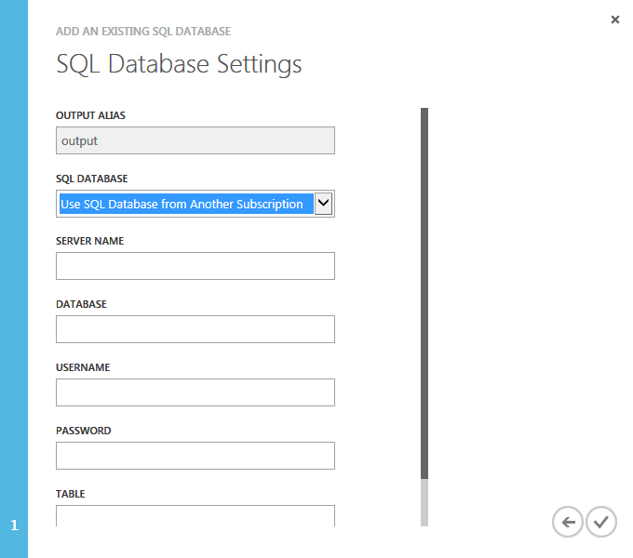
設定串流分析工作的輸出
Currently three data stores are supported as outputs: Blob Storage, SQL Database and Azure Event Hub.
For SQL Database The schema of the table schema and the schema of query output must be compatible.
Notes:
The Azure portal provides wizards to guide the user through the processing of add an output. The process for adding outputs to a Job is similar to that of adding inputs. The wizard collects all the information required to connect and store the results in the ouptput.
In addition to Blob Storage and Event Hubs, ASA also supports storing the results in an Azure SQL Database. Note that when you use an Azure SQL database the schema of the result event and the Azure SQL database table must be compatible.
Just as with inputs you have to define the serialization formats for blob storage and event hubs. The three supported formats are CSV, JSON and Avro. Utf-8 is the supported encoding format.

Slide 36
建立工作的流程
Notes:
Speaker Notes
Now that the inputs and an output have been added to the Job and the query has been developed the Job can be started. The Job can be started by just clicking on the start button. It usually takes a few minutes for the Job to start and get ready to process the input. You can check the status of a job by looking at the operation logs (covered later).
However before you start a job you will want to specify a couple of policies on how the job should handle out of order events and also how to process any historical data in the inputs. Let us understand how to specify these two policies.

Slide 37
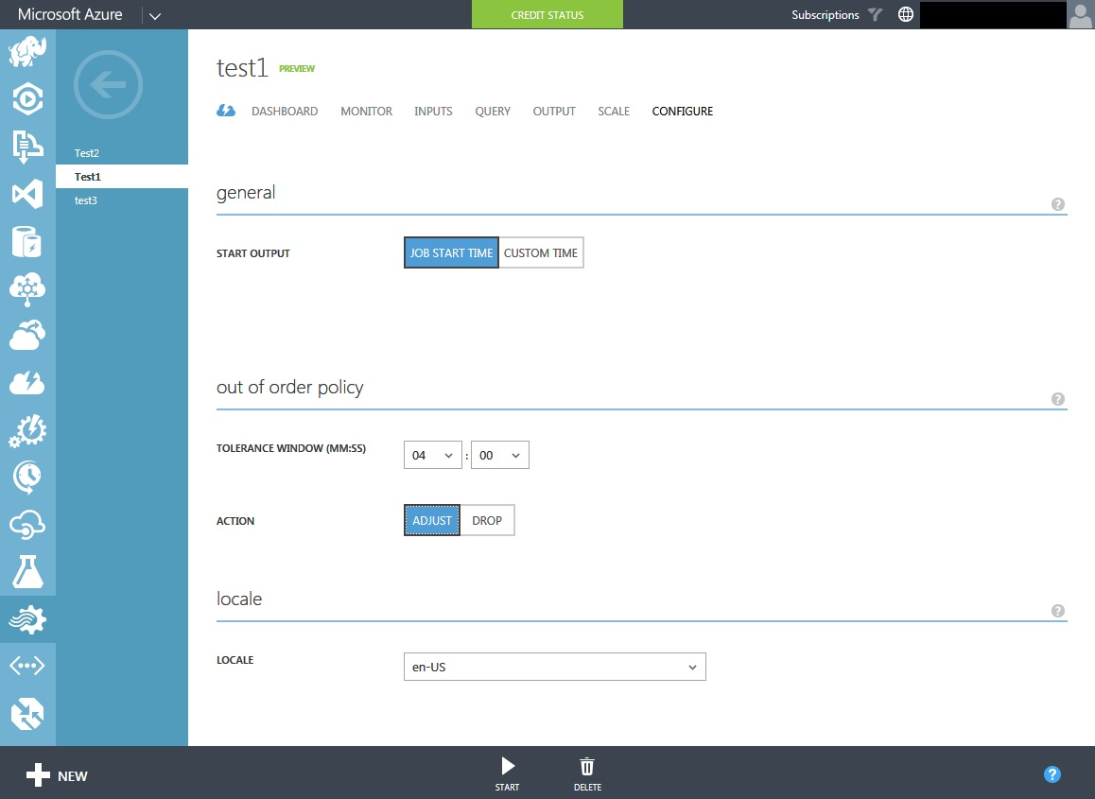
亂序執行原則
For events received “out of order””
Drop policy: All events that are received out of order are dropped (not processed).
Adjust policy: Timestamps for out of order events are changed to the timestamp of the last correctly ordered event.
Tolerance Window:
Timestamps of events arriving within the tolerance window will be reordered automatically.
Events arriving outside the tolerance window will either be dropped or adjusted based on the out of order policy.
Notes:
For handling events that are received out of order, you can use a Tolerance Window to automatically reorder events that arrive within the specified timeframe. If a window is not specified or if events arrive outside of the window, one of the following actions will be taken: Drop or Adjust. If you want to delete events that are received out of order, select Drop. If you want to keep out of order events and change their timestamps to the last correctly ordered event, select Adjust.

Slide 38
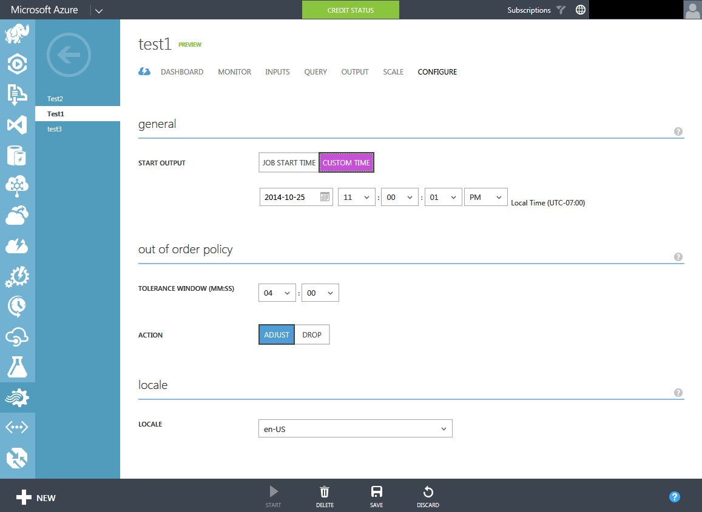
開始輸出
For input sources with time data, can specify when you want to start your output (the default is the job start time).
Useful when there is historical input to consume
Useful to start a stopped job to resume from when it stopped.
Notes:
If your input sources have time data, you can specify ‘when’ you want to start your output. The default is the job start time. Note that the source must have time data (e.g. Event Hubs). There are two cases where this feature is useful:
When you have historical data to consume. You might want to run analytics on the historical data for comparison, testing etc.
You stopped a Job and restarted it later. You might want the Job to start processing input data from the time it stopped, not current time. Otherwise some of the input events – that arrived between the time the job stopped and the current start time – may not be processed.

Slide 39
建立工作流程
Notes:
Not that you have started the Job, the next step is to monitor the job. Typically you want to monitor the job for performance, errors etc. We will understand how to monito a Job using the Azure Portal

Slide 40
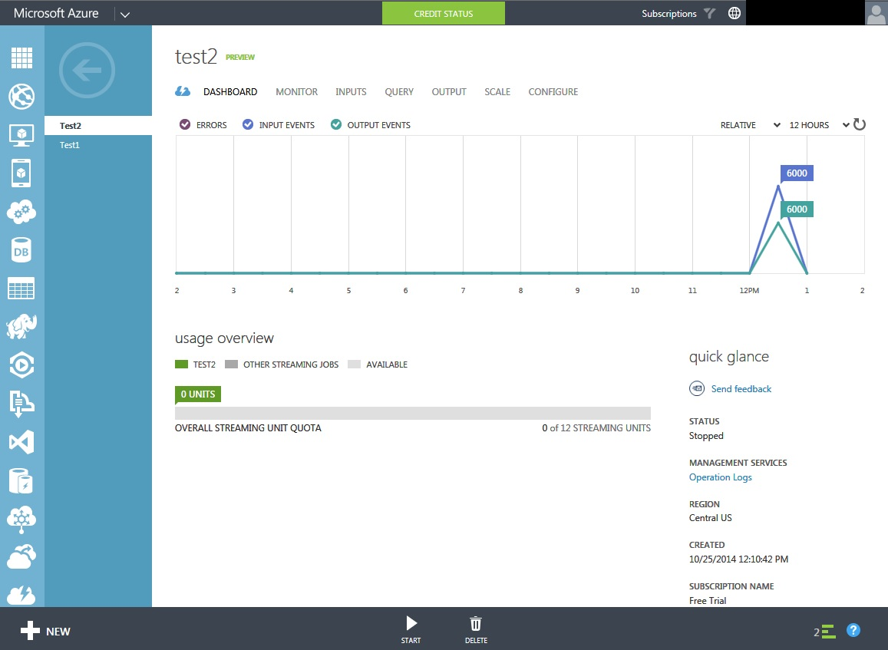
儀表板
The Stream Analytics dashboard provides:
high-level view of performance status
access to commands
interface to Start, Stop, and Delete Jobs
allocation of Streaming Units to jobs
access to operation (Service) logs.
Notes:
The Dashboard is where you can find information such as:
high-level view of performance status
access to commands
interface to Start, Stop, and Delete Jobs
allocation of Streaming Units to jobs
access to operation (Service) logs.

Slide 41
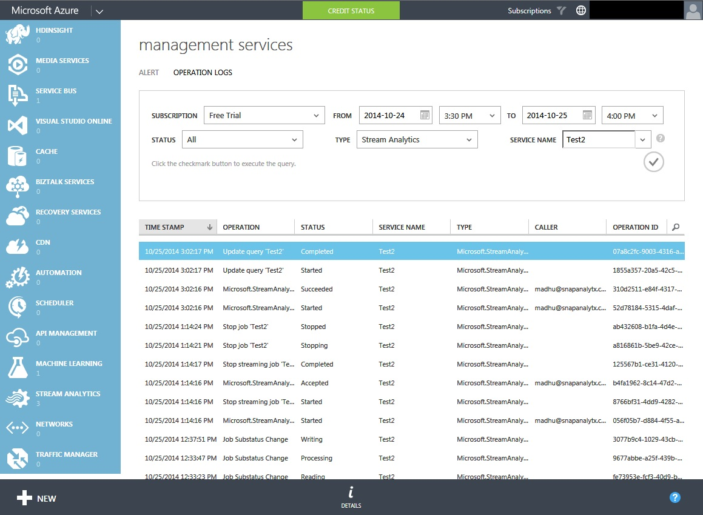
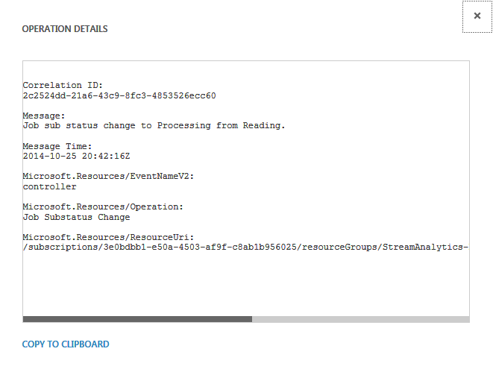
操作記錄檔
Operation Logs is accessible via the Dashboard
Shows the status of a job:
Stopped
Started
Initializing
Idle
Running
Processing
Writing
…
Details link (bottom of page) pops up more details
Notes:
Operation logs show the status of a Job. It is a great debugging tool to at least understand what a job is currently doing. Some of the states of a job include:
Initializing – This is the state right after you click start.
Started – Job has started
Reading – The job is waiting to read data from inputs
Processing – The job is processing the input i.e. executing the queries
Writing – The job is writing results to the output
Idle – Job is idling
Stopped – Job is stopped.
Operation logs can be accessed from a link on the Dashboard.
For each state of the Job you can get more details by clicking on the DETAILS icon at the bottom of the page.

Slide 42
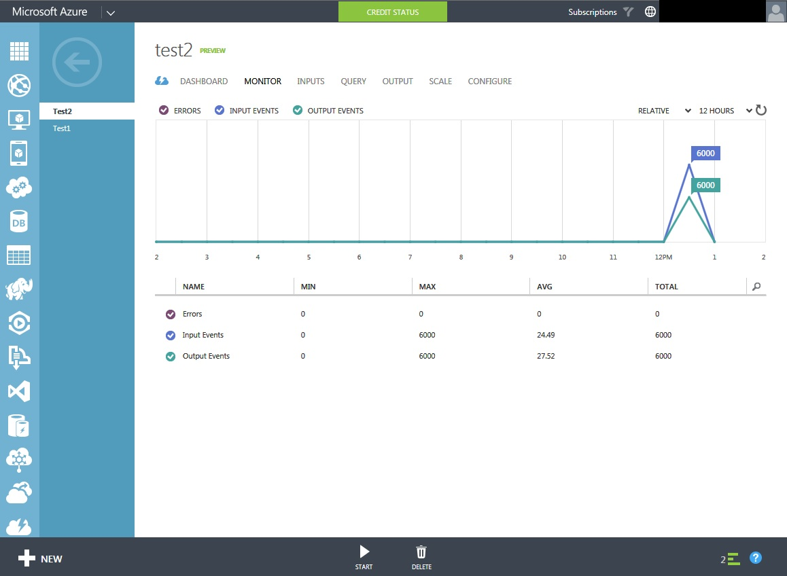
監控工作執行狀況
The Azure Management Portal shows key usage and performance metrics:
Latency (min, max and average)
Incoming throughput: Measure of data received by the Stream Analytics Job (in bytes)
Outgoing Throughput: a measure of data sent by the stream analytics job to output source (in bytes)
Error Count: number of error messages incurred by a stream analytics job
Metrics can be added to or removed from the chart
Notes:
When you click on the “Monitor” tab you get o see key performance metrics for each of the jobs including latency, incoming/outgoing throughput and error count.
Metrics of interest can be added to or removed from the chart.
You can see the metrics for the past 1 hour, 12 hours, 24 hours and 7 days.
The number can be seen as absolute values or relative to each other.

Slide 43
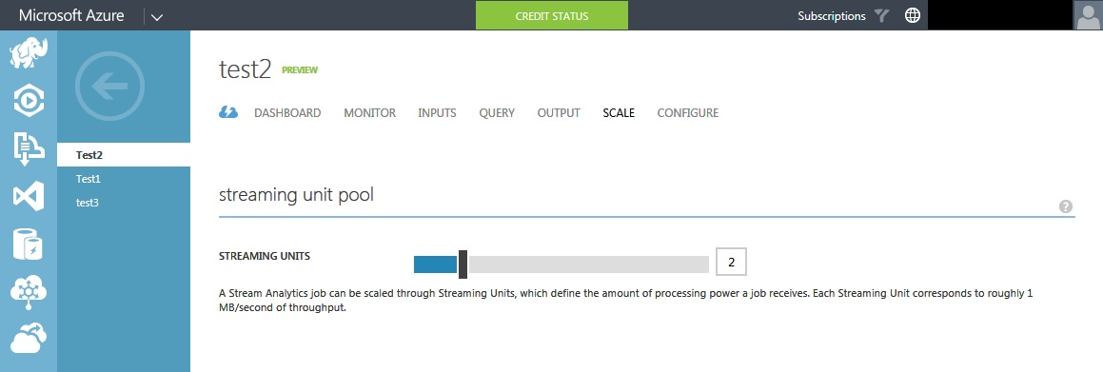
延展串流處理單位
Is a measure of the computing resource available for processing a Job
Each streaming unit provides up to 1 MB/second throughput.
Each job needs a minimum of one streaming unit (default)
Number of Streaming Units required for a job depends on:
rate of incoming events
complexity of the query
Total number of streaming units that can be used by a Stream Analytics job depends on:
number of steps in the query defined for the job and
number of partitions for each step.
Notes:
The resource available for processing Stream Analytics jobs is measured by Streaming Unit. Each streaming unit can provide up to 1 MB/second throughput. Each job needs a minimum of one streaming unit, which is the default for all jobs. You can allocate up to 12 streaming units for a Stream Analytics job using the Azure Management portal.
The number of streaming units that your need for a job depends on the expected performance. The performance depends on the rate at which the events are arriving (events per second), the size of the events (bytes/sec) and the complexity of the query. Allocating more streaming units can improve the performance of the query i.e. the number of events it can process. The number of streaming units that can be consumed by a job depends on the number of steps and the number of partitions. An un-partitioned step can only consume 12 streaming units.
Note that streaming units cost money … so be careful with how many streaming unit you allocate.

Slide 44
透過分割進行延展
When a query is partitioned, input events will be processed and aggregated in a separate partition groups
Output events are produced for each partition group
Partitioning allows for parallel execution and scale out
To read from Event Hubs ensure that the number of partitions match
Requirements:
The input source must be partitioned
The select statement of the query must read from the partitioned input source
The query within the step must have the Partition By keyword
SELECT COUNT(*) AS Count, TollBoothId
FROM EntryStream Partition By PartitionId
GROUP BY TumblingWindow (minute, 3), TollBoothId
Stream Analytics
Event Hub
PartitionId = 1
Step
Result 1
PartitionId = 2
Step
Result 2
PartitionId = 3
Step
Result 3
PartitionId = 1
PartitionId = 2
PartitionId = 3
Notes:
Partitioning a step enables more streaming units to be allocated to a job as there is a limit on the number of units that can be assigned to an un-partitioned step.
Partitioning requires that all three conditions listed in the slide be satisfied.
When a query is partitioned, the input events will be processed and aggregated in separate partition groups, and outputs events are generated for each of the groups. If a combined aggregate is desirable, you must create a second non-partitioned step to aggregate.
The preview release of Azure Stream Analytics doesn't support partitioning by column names. You can only partition by the PartitionId field, which is a built-in field in your query. The PartitionId field indicates from which partition of source data stream the event is from.
Since Event Hubs supports partitioning, you can easily develop partitioned queries that read data from Event Hubs.

Slide 45
使用 REST APIs 操作工作
Jobs Management
Start Job
Stop Job
Create Job
Delete Job
List Jobs
Update Job
The full functionality of Azure Stream Analytics is through REST APIs.
Enables programmatic access
Useful for automation through scripting
Embed in other applications/tools
Input and Output
Management
Create Input / Output
Delete Input / Output
List Input / Output
Update Input / Output
Transformations
Management
Create Transformation
Delete Transformation
Get Transformation
Update Transformation
Notes:
The full functionality of Azure Stream Analytics is through REST APIs.
REST APIs enables programmatic access either through a browser (using Javascript for example) or through a native Windows/Linux client or even a mobile device.
REST APIs are useful for automation through scripting.
Also they can be used to embed access to ASA through other management tools.
All task operations conform to the HTTP/1.1 protocol specification and each operation returns an x-ms-request-id header that can be used to obtain information about the request. You must make sure that requests made to these resources are secure. For more information, see Authenticating Azure Resource Manager requests.

Slide 46
Learn and Do More
Azure Stream Analytics
Getting Started Using Stream Analytics: http://azure.microsoft.com/en-us/documentation/articles/stream-analytics-get-started/
ASA – Developer Guide: http://azure.microsoft.com/en-us/documentation/articles/stream-analytics-developer-guide/
Microsoft Open Tech ConnectTheDots sample IoT with Event Hubs and Azure Stream Analytics: https://github.com/MSOpenTech/connectthedots/wiki

Slide 47

© 2014 Microsoft Corporation. All rights reserved. Microsoft, Windows, Windows Vista and other product names are or may be registered trademarks and/or trademarks in the U.S. and/or other countries.
The information herein is for informational purposes only and represents the current view of Microsoft Corporation as of the date of this presentation. Because Microsoft must respond to changing market
conditions, it should not be interpreted to be a commitment on the part of Microsoft, and Microsoft cannot guarantee the accuracy of any information provided after the date of this presentation.
MICROSOFT MAKES NO WARRANTIES, EXPRESS, IMPLIED OR STATUTORY, AS TO THE INFORMATION IN THIS PRESENTATION.

